Slide 1
Part –II
DIGITAL ELECTRONICS
Chapter -6 : FLIP FLOPS AND ITS APPLICATIONS

Slide 2
CLASSIFICATION OF DIGITAL CIRCUITS
COMBINATIONAL CIRCUITS :
Examples:
Half Adder, Full Adder etc.
Digital Circuit
Input
Output
Department of Electronics and Communication Engineering, MIT, Manipal
Notes:
Combinational Logic
Circuits that change state depending upon the actual signals being applied to their inputs at that time

Slide 3
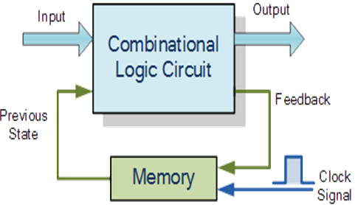
CLASSIFICATION OF DIGITAL CIRCUITS
SEQUENTIAL CIRCUITS:
Simple sequential logic circuits can be constructed from standard Bi-stable circuits such as Flip-flops.
Notes:
SEQUENTIAL CIRCUITS:
The word “Sequential” means that things happen in a “sequence”, one after another and in Sequential Logic circuits, the actual clock signal determines when things will happen next.
In sequential circuits a feedback is always present. Due to this feedback, these circuits have memory. A memory element is a device which can store information in terms of 1 or 0 and its state can be modified by clock signal and data inputs.
Simple sequential logic circuits can be constructed from standard Bi-stable circuits such as Flip-flops.
Practical Examples
Traffic Lights
Digital watches
Timers
Memory sticks
CD

Slide 4
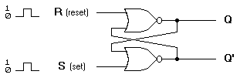
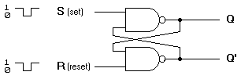
Flip-Flop
An electronic device which is used to store one bit of data
Can be constructed from NAND gates or NOR gates
NOR Logic
NAND Logic
Notes:
Flip Flop
One bit memory element which can store 1 or 0
Can be constructed from NAND gates or NOR gates
Has two stable outputs Q and Q’ so it is known as
Bi-stable circuit.

Slide 5

Clock signal
Clock is usually a square wave.
Edges and levels of clock
Positive pulses
Positive edges
Negative edges
Notes:
A “clock” is a special circuit that sends electrical pulses
through a circuit
• Clocks produce electrical waveforms of the form square waves
􀂾 each pulse has a precise width
􀂾 there is a precise interval between pulses – known
as clock cycle time

Slide 6
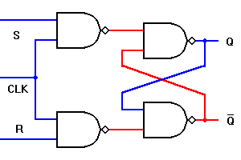
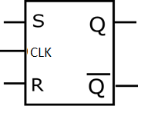
SR Flip Flop
Logic Diagram of SR flip flop.
Logic Symbol of SR flip flop
Table 1: Truth table of SR Flip flop.
CLK | S | R | Q(n+1) | Mode
1 | 0 | 0 | Qn | Previous Output
1 | 0 | 1 | 0 | Reset
1 | 1 | 0 | 1 | Set
1 | 1 | 1 | Invalid | Invalid
0 | X | X | Qn | Previous Output
Notes:
During Clk High:
When S input is made ‘1’ and R input is made ‘0’, the Q output takes the state ‘1’. We call this as SET condition.
When S input is made ‘0’ and R input is made ‘1’, the Q output takes the state ‘0’. We call this as RESET condition
When S = R = ‘0’ . the SR flip flop exhibits the memory. i.e. Q_{n+1} = Q_{n}
S = R = 1 is the Invalid Condition.
During Clk Low:
Irrespective of S and R inputs, the SR flip flop exhibits the memory. i.e. Q_{n+1} = Q_{n}

Slide 7
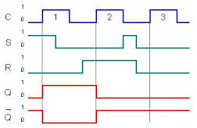
Timing Diagram of SR Flip Flop
Identify the edge of triggering
Analyze the output Q for different type of triggering

Slide 8
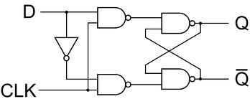
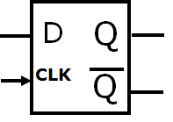
D Flip Flop
(a) Logic Diagram of D flip flop. (b) Logic Symbol of D flip flop.
Table2: Truth table of D flip flop.
CLK | D | Q(n+1) | Mode
1 | 0 | 0 | Reset
1 | 1 | 1 | Set
0 | X | Qn | Previous Output

Slide 9
Exercise 1: Complete the timing diagram
D
Q
En
Q
En
D
Q
Q

Slide 10
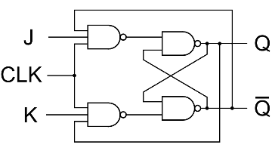

JK Flip Flop
(a) Logic Diagram of JK flip flop.
(b) Logic Symbol of JK flip flop.
Table 3: Truth table of JK Flip flop.
CLK | J | K | Q(n+1) | Mode
1 | 0 | 0 | Qn | Previous Output
1 | 0 | 1 | 0 | Reset
1 | 1 | 0 | 1 | Set
1 | 1 | 1 | Qn’ | Toggle
0 | X | X | Qn | Previous Output
Notes:
During Clk High:
J = K = 0 causes memory condition.
J = 0 & K = 1 causes reset condition.
J = 1 & K = 0 causes set condition.
J = K = 1 causes output to toggle. i.e. Q_{n+1} = Q_{n}’
During Clk low:
Irrespective of J & K inputs, the J-K flip flop exhibits the memory condition.

Slide 11
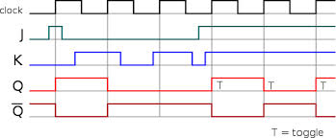
Timing diagram of JK flip-flop

Slide 12
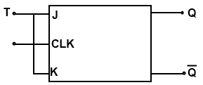
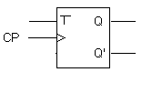
T Flip-flop
(a) Logic Diagram of T flip flop.
(b) Logic Symbol of T flip flop.
Table 4: Truth table of T flip flop.
CLK | T | Q(n+1) | Mode
1 | 0 | Qn | No change
1 | 1 | Qn’ | Toggle
0 | X | Qn | No change

Slide 13
Symbolic Representation of Edge-Triggered Flip-flops
S-R, D and J-K edge-triggered flip-flops. Note the “>” symbol at the clock input.
S
C
R
Q
Q'
D
C
Q
Q'
J
C
K
Q
Q'
Positive edge-triggered flip-flops
S
C
R
Q
Q'
D
C
Q
Q'
J
C
K
Q
Q'
Negative edge-triggered flip-flops

